Slide 1
Pulmonary Pathology
DR MARTIN GODDARD
BA MB BCH FRCS FRCPATH

Slide 2
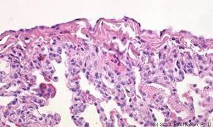
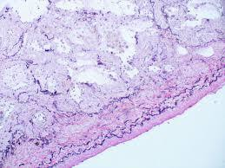
Pleural disease
Normal pleura
Mesothelial layer
Connective tissue layer
Superficial elastic layer
Loose connective tissue with vessels and lymphatics
Deep fibro-elastic layer

Slide 3
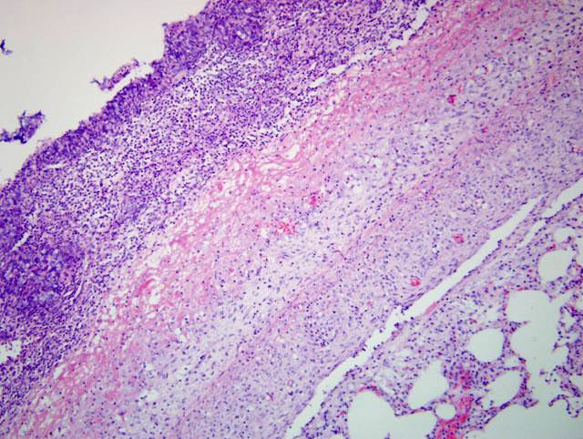
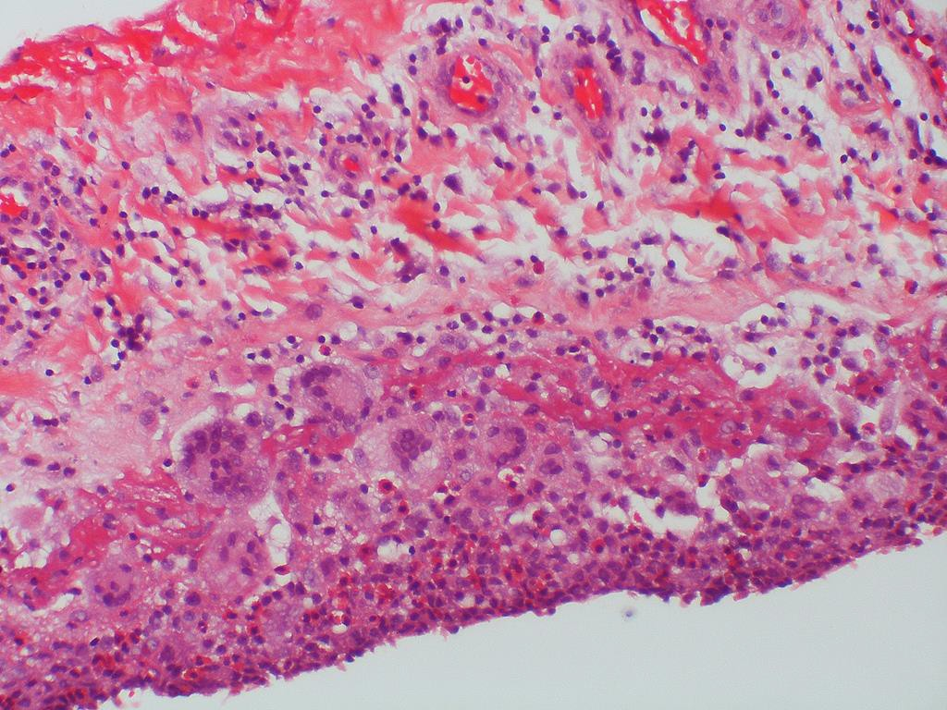
Pleural diseases
Inflammation and fibrosis
Infection
Pulmonary infarction
Connective tissues disease
Drugs
Asbestos
Pneumothorax
Sarcoid
Radiation
Renal failure

Slide 4
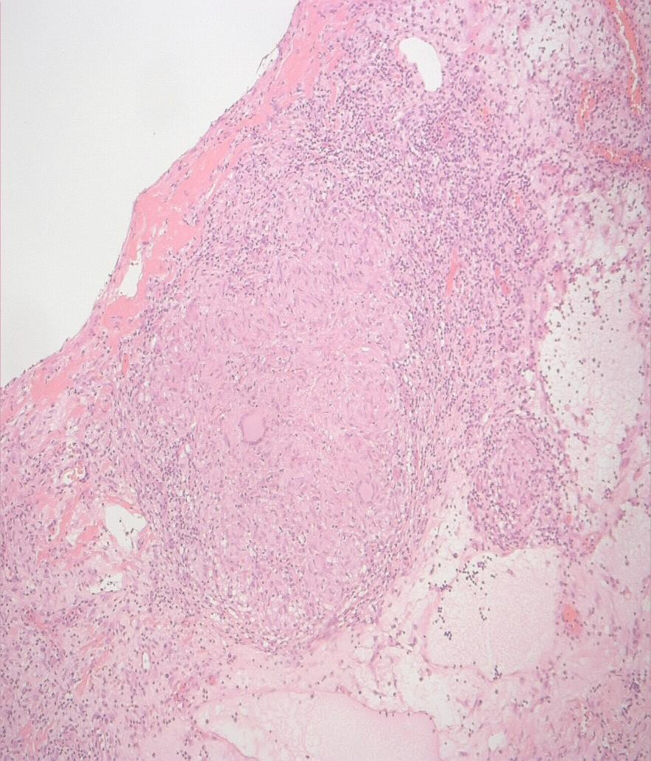
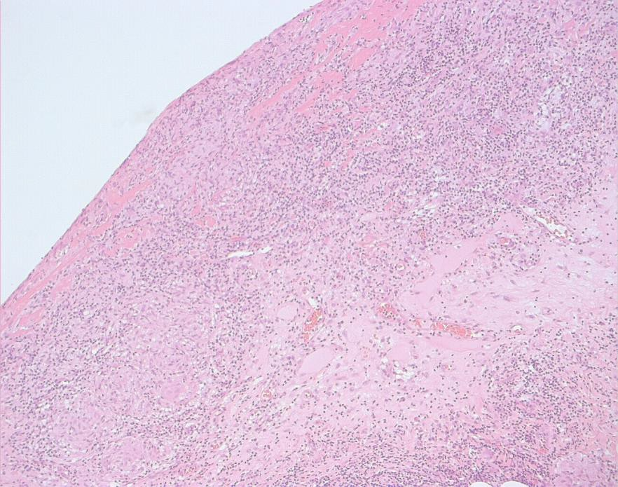
Case 18,
Case 18
F53 Unexplained pleural thickening a
nd effusion.

Slide 5
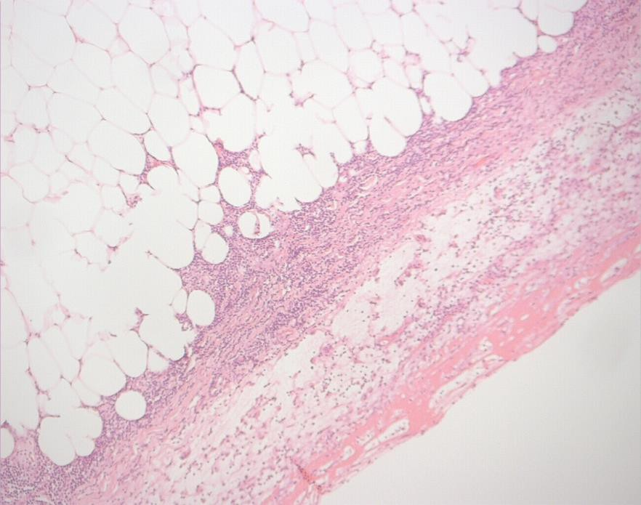
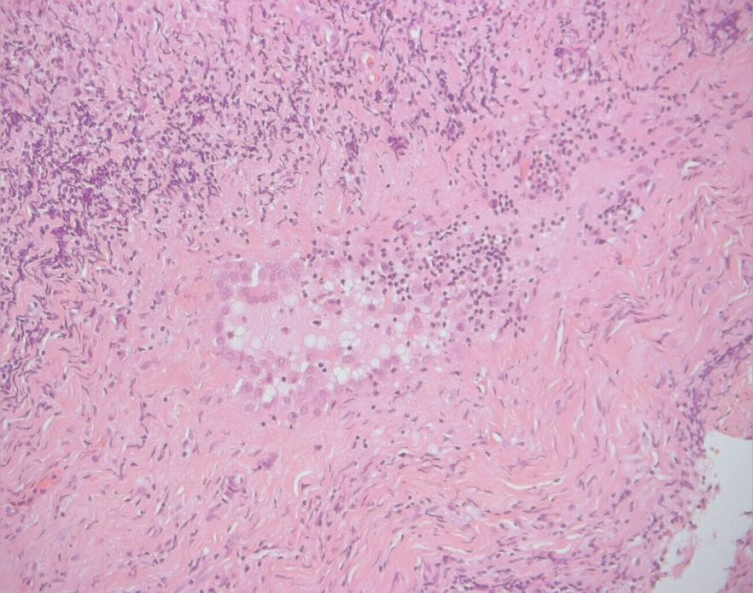
18
Pitfalls
Layers
Maturation
Entrapment

Slide 6
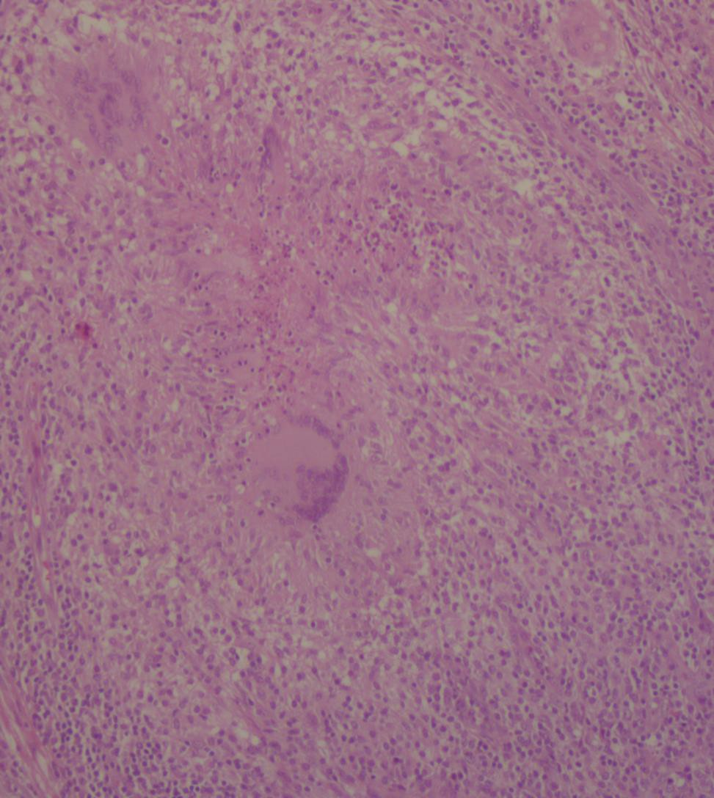
Granulomas
Sarcoidosis
Tuberculosis
Rheumatoid nodules

Slide 7
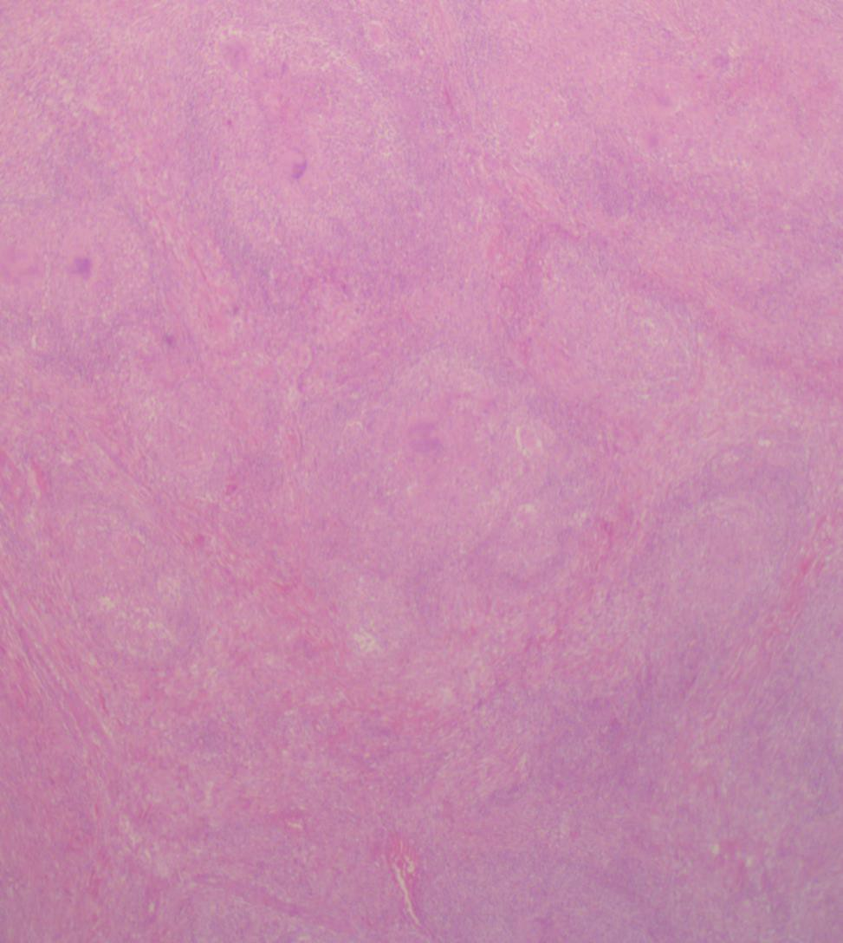
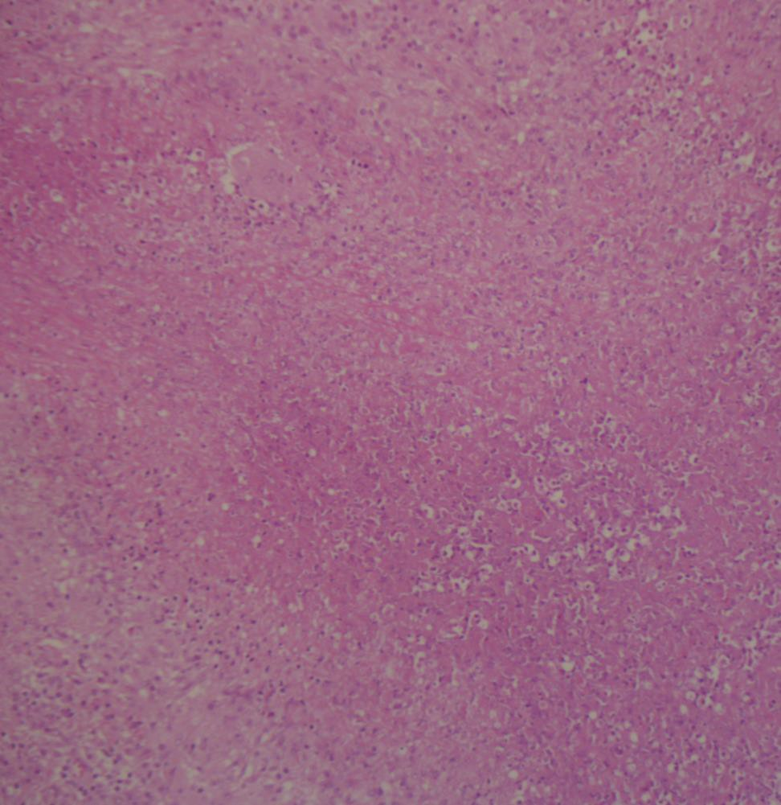

Slide 8
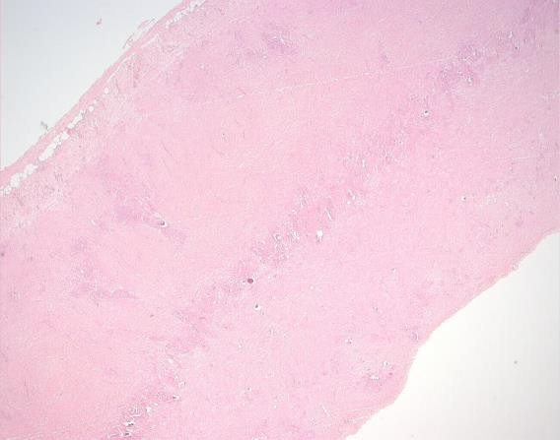
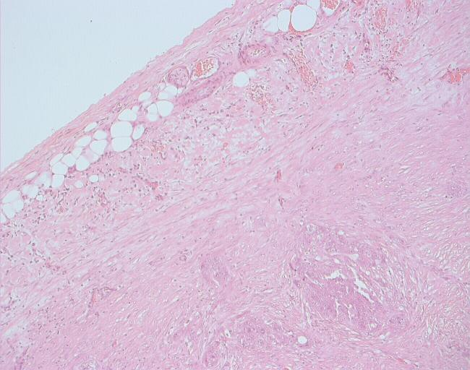
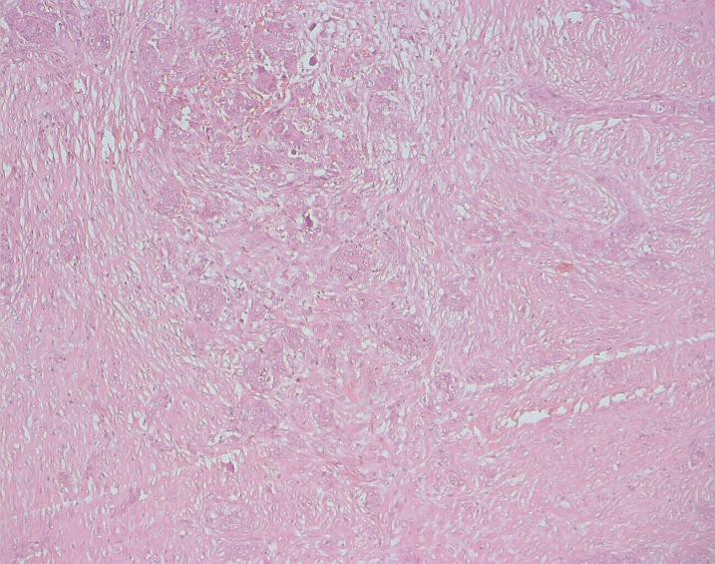
Case 2
F 66
Increasing shortness of breath Pleural effusion.

Slide 9
Differential diagnosis
2
Mesothelioma | Adenocarcinoma
CEA, LeuM1, Ber EP4, AUA-1 negative | CEA, LeuM1, Ber EP4, AUA-1 positive
EMA – membrane positivity | EMA – cytoplasmic and cell periphery
CK5/6, calretinin(nuclear), thrombomodulin positive | Negative
Adenocarcinoma vs Mesothelioma
Immuno panels

Slide 10
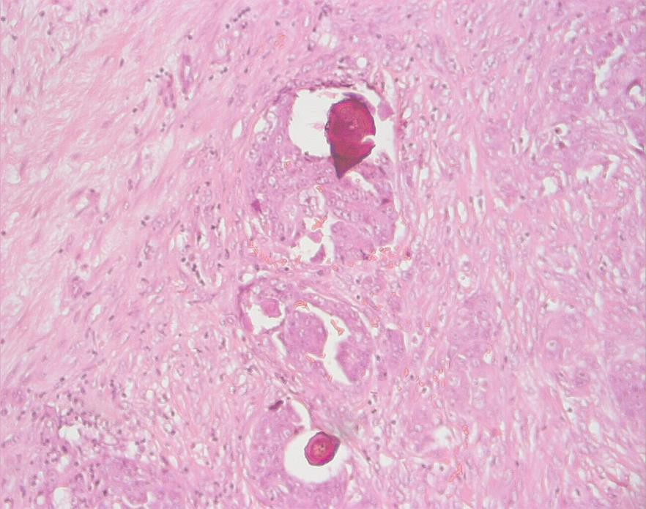
2
Marker | Sensitivity % | Specificity %
CK5/6 | 83 | 85
Calretinin | 82 | 85
N Cadherin | 78 | 84
WT-1 | 77 | 96
Thrombomoduli n | 61 | 80
Metastatic Ovarian carcinoma

Slide 11
Mesothelioma vs Mesothelial
hyperplasia
Papillary change on surface or entrapment can mimic mesothelioma.
Entrapped – parallel to surface
EMA and p53 – malignant> reactive
Desmin – reactive> malignant
May be helpful but still relies on morphological features

Slide 12
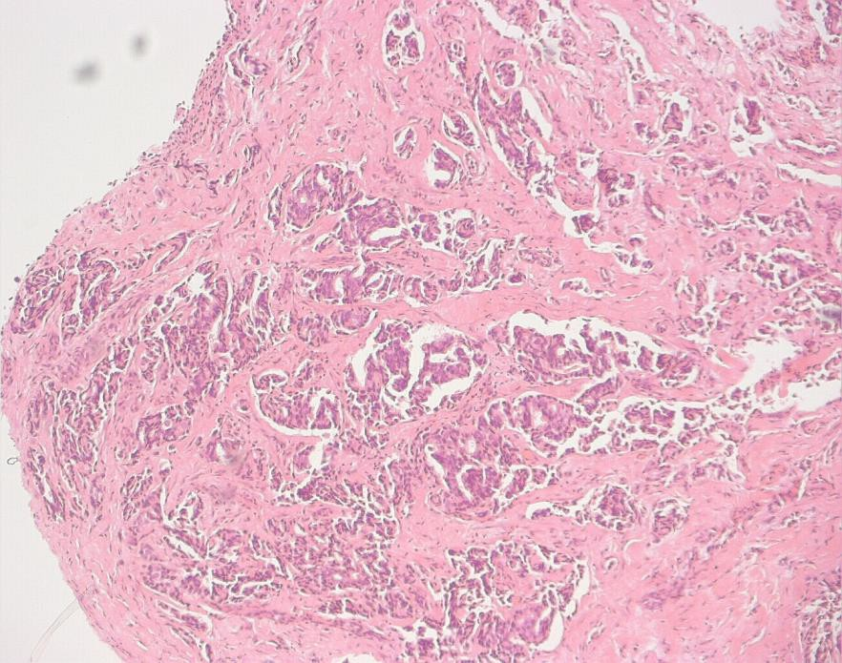
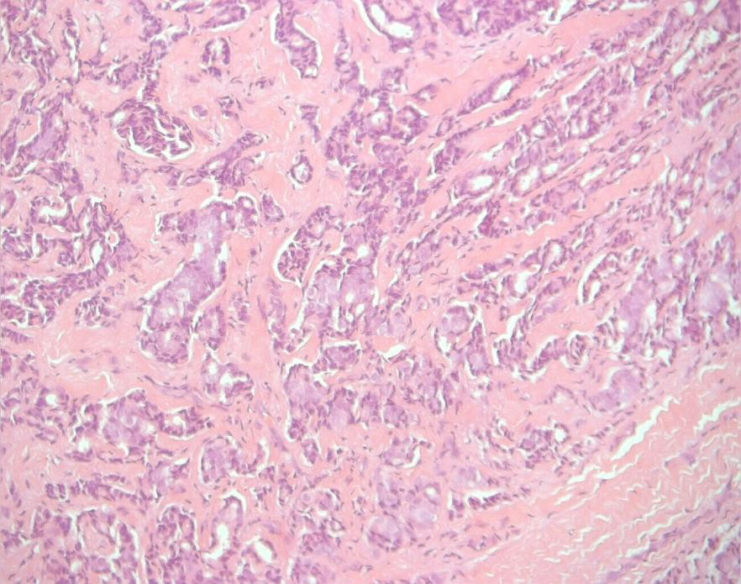
3
F53
Short of breath
No asbestos exposure Pleural effusion

Slide 13
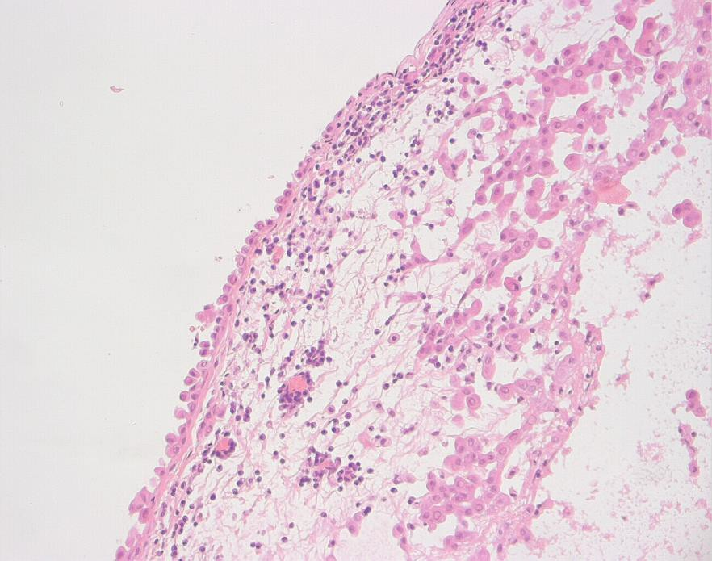
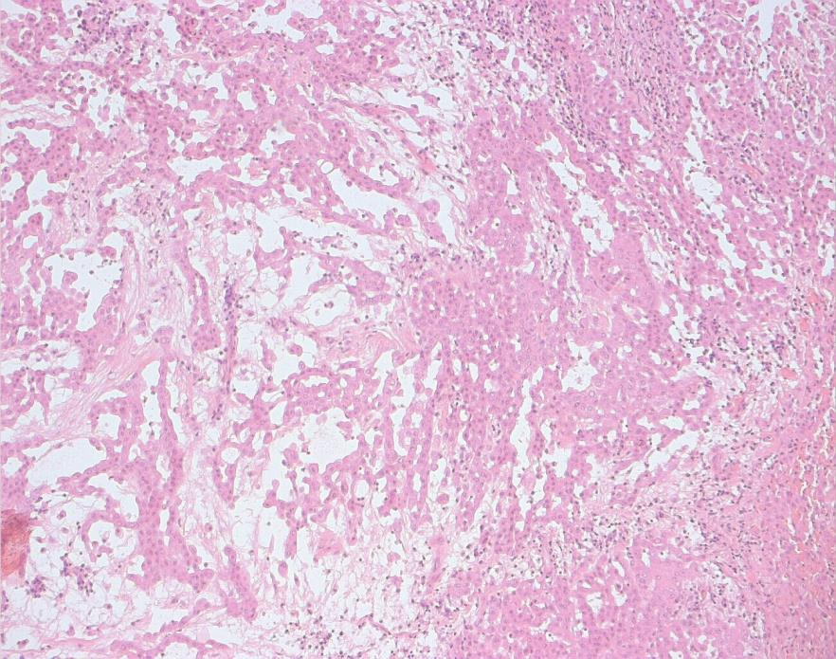
Case 11
M74
Shortness of breath Pleural effusion

Slide 14
Mesothelioma
Differential diagnosis
Epithelioid vs Adenocarcinoma
Biphasic and other biphasic tumours
Epithelioid and reactive
Sarcomatoid and spindle cell tumours
Sarcomatoid vs fibrosis
Epithelioid
Biphasic Sarcomatoid

Slide 15
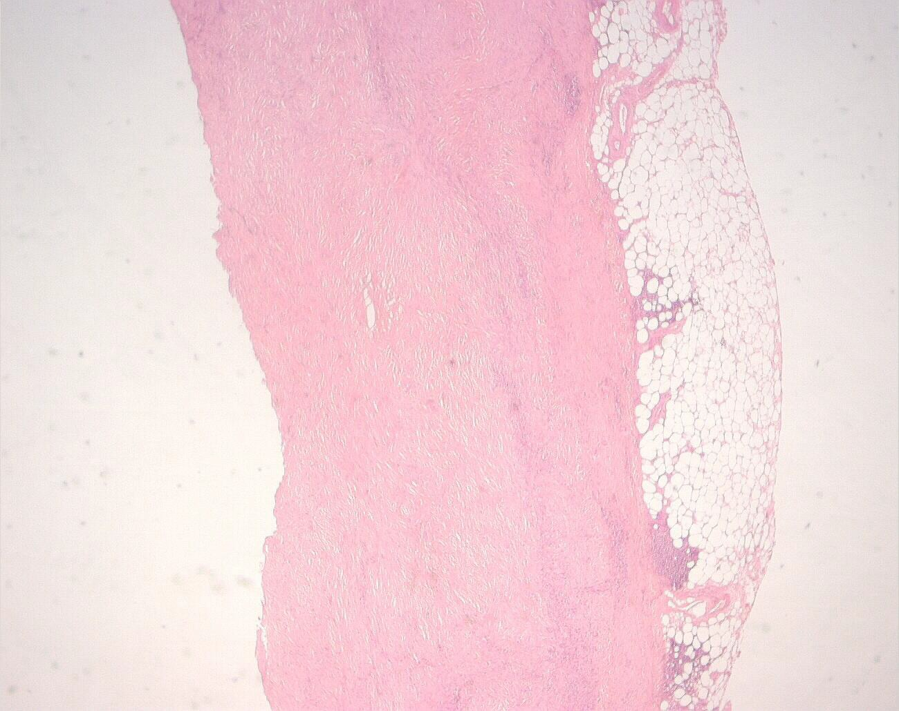
Case 29
M71
Pleural effusion and pleural thickening

Slide 16
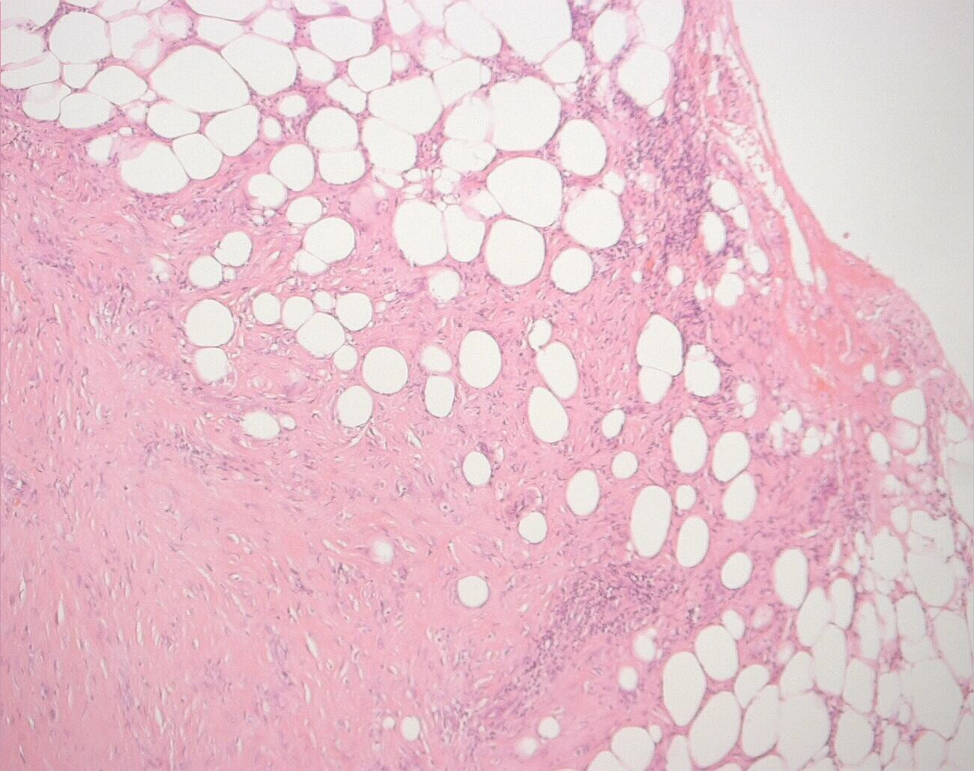
29
Maturation
Architecture Fatty infiltration

Slide 17
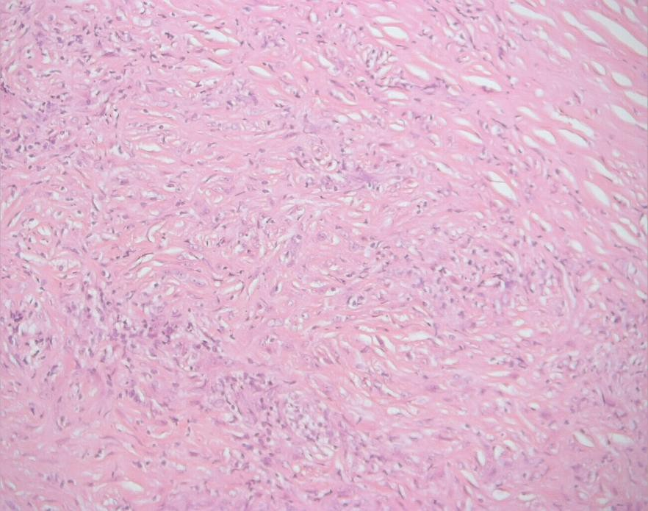
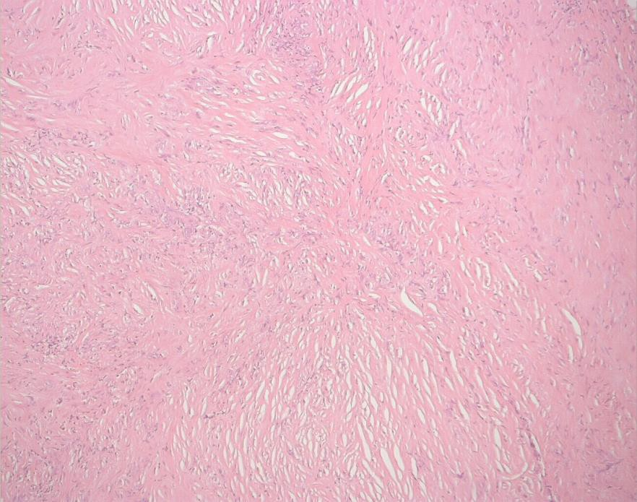
29

Slide 18
Sarcomatoid mesothelioma
 | Pan cytokerati n | CK5/6 | Calretinin | Thrombo modulin | SMA | TTF-1 | D2/40
Sarcomatoid mesotheliom a | 70% | rare | 70% | 70% | 60% | 0/10 | 87%
Sarcoma | 17% | Rare | 17% | 38% | 58% | Negative
Sarcomatoid carcinoma | 90% | Rare | 60% | 40% | 10% | Positive if pulmonary (maybe) | 26%

Slide 19
Solitary fibrous tumour
Histology
Well circumscribed
Variable cellularity in fibrous stroma Mitoses in more cellular areas Myxoid change
Origin ultrastructurally in myofibroblasts
Express vimentin +/- actin
Usually attached to the pleura but may be intra-pulmonary or in the chest wall

Slide 20
SFT – Immunohistochemistry
Vimentin, actin +ve Malignant features
Hypercellularity
Mitoses >4/10HPF
Pleomorphism
Necrosis
Cytokeratin, EMA –ve
CD34 (80%) ( not in MFH or HPCT)
P53 in higher grade tumours

Slide 21
LUNG TUMOURS

Slide 22
LUNG TUMOURS
Risk factors
Smoking
Asbestos
Irradiation
Arsenic, nickel, chromium, polyaromatic hydrocarbons
Pulmonary fibrosis – 14x risk
Hereditary
Pre-malignancy
Squamous metaplasia and dysplasia
Atypical adenomatous hyperplasia and Adenocarcinoma in situ

Slide 23
WHO classification of lung tumours
Adenocarcinoma
Lepidic, acinar, papillary, micropapillary,solid
Invasive mucinous carcinoma
Colloid, foetal,enteric
Minimally invasive
Squamous cell carcinoma
Keratinising, non-keratinising, basaloid
Neuroendocrine tumours
Small cell, Large cell NE
Carcinoid – typical, atypical
Large cell carcinoma Adenosquamous carcinoma Sarcomatoid carcinoma
Pleopmorphic
Spindle cell
Giant cell
Carcinosarcoma
Pulmonary blastoma

Slide 24
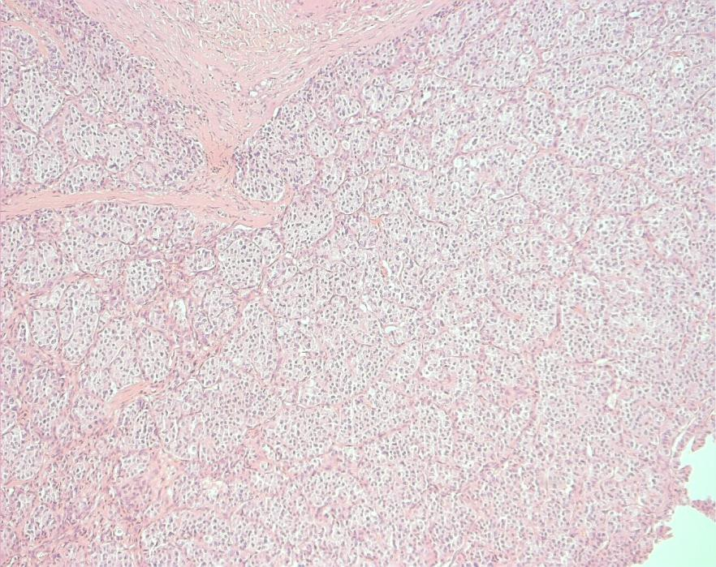
7
7
F53
Mass obstructing upper lobe bronchus

Slide 25
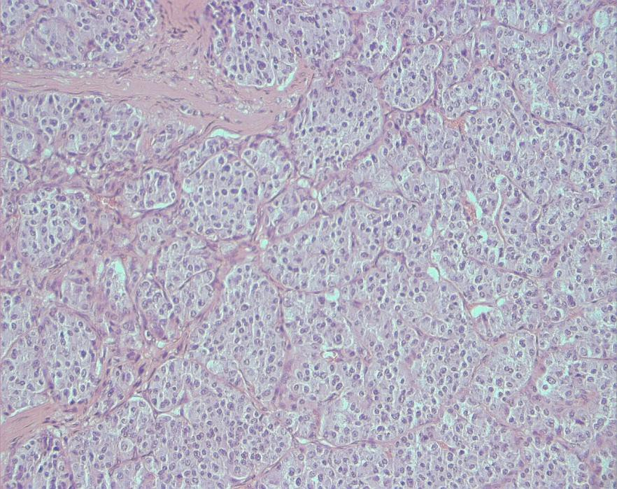
Organoid architecture
7
Nest and trabeculae
Mitotic rates – Ki67 staining Immunohistochemistry

Slide 26
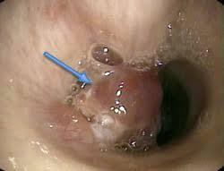
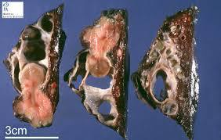
7
Neuroendocrine tumours of low grade malignancy
5% of pulmonary tumours Mean age 50
Often in airways leading to obstruction May extend through wall
Hilar nodes at resection <5%

Slide 27
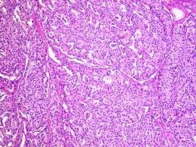
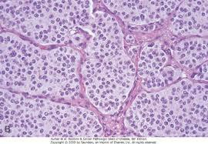
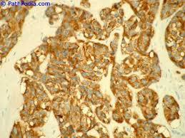
Trabecular, mosaic patterns
Delicate fibrovascular stroma
Granular chromatin, indisctinct nucleoli Mitoses <2/2mm²
CD56, Chromogranin, Synaptophsin

Slide 28
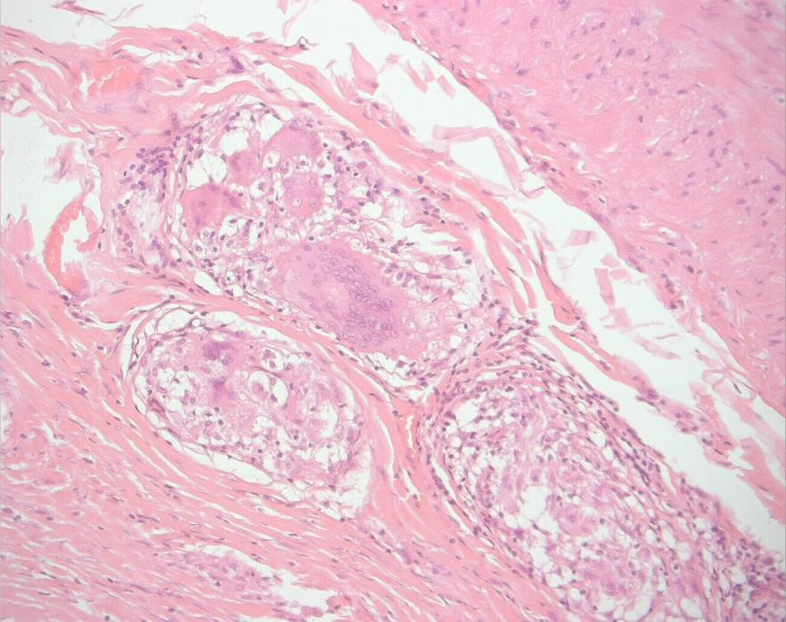
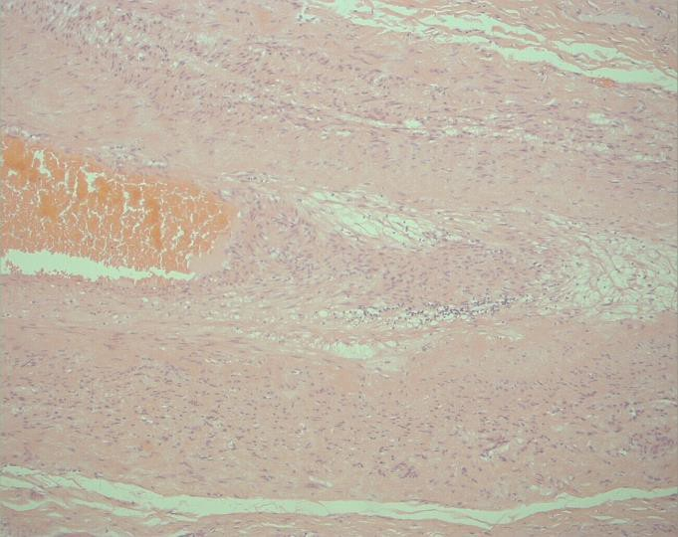
Co-existent sarcoidosi
s
Dual pathologies ae not uncommon Granulomas
Always exclude infection
Infections
ILD
Vasculitis
OLD
Sarcoid

Slide 29
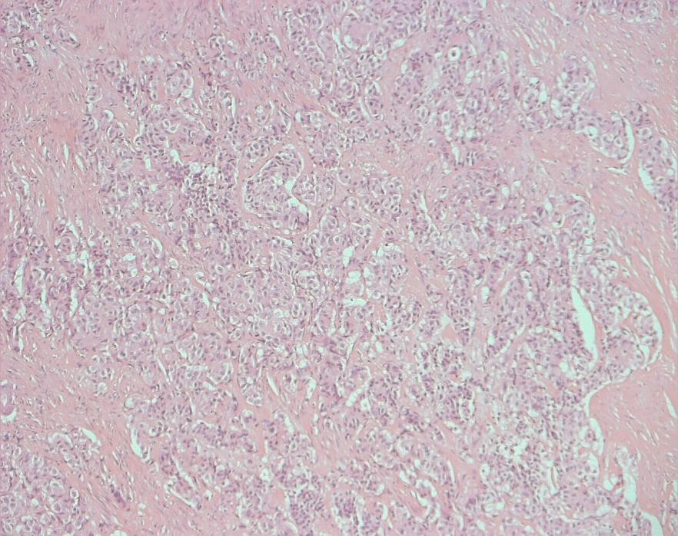
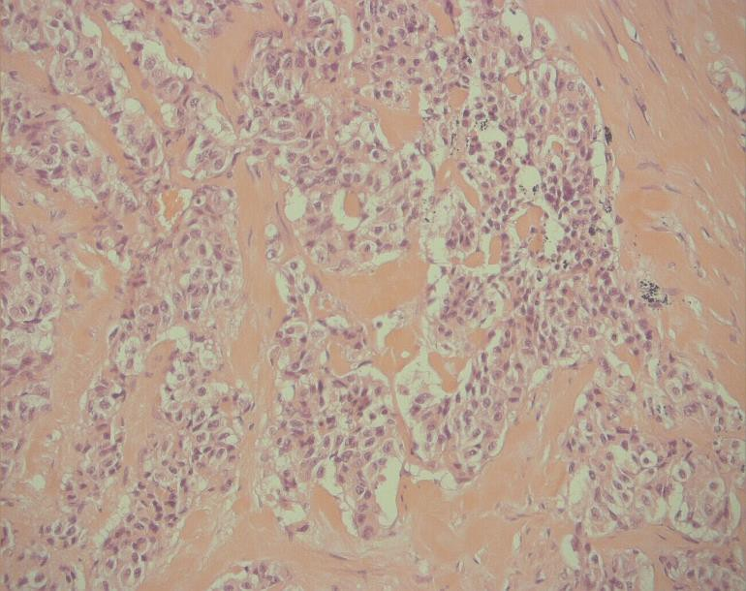
8,31
8 M 63
Mass in right bronchus Liver metastases
31
Mass in left upper lobe

Slide 30
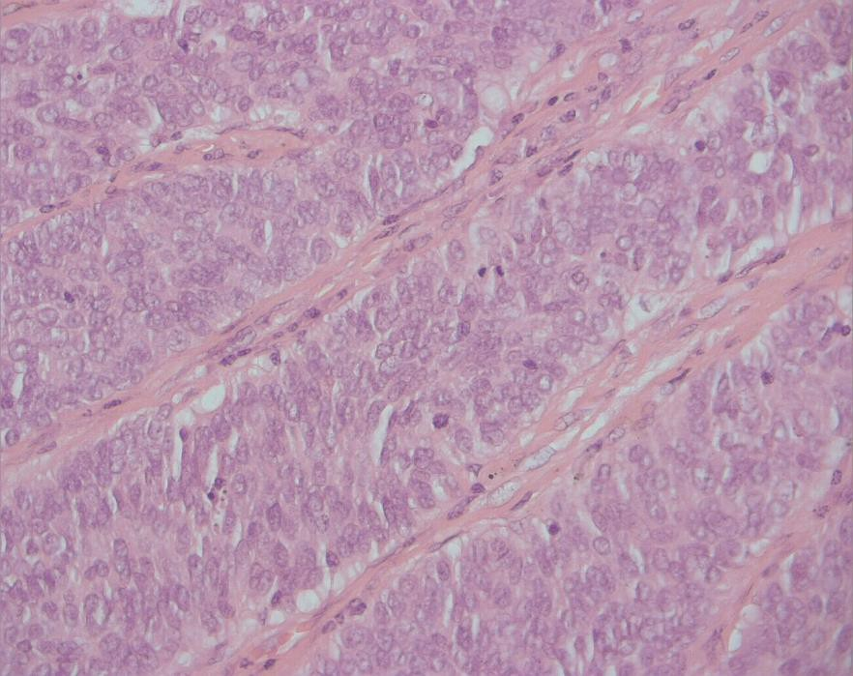
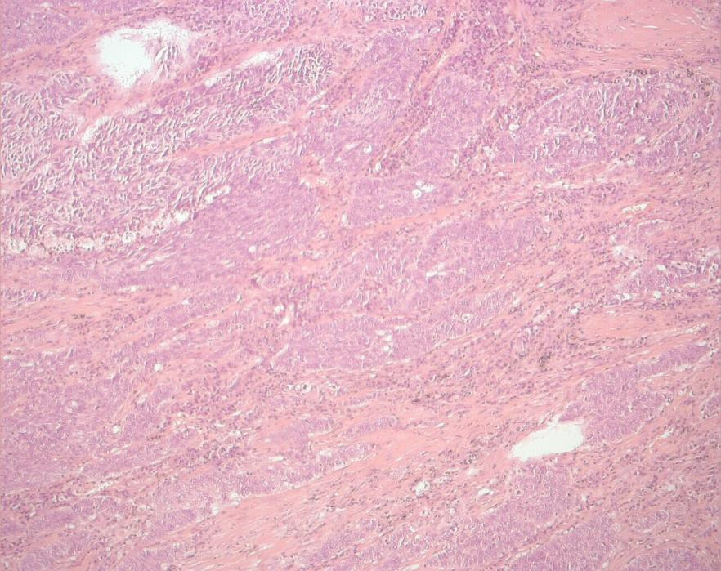

Slide 31
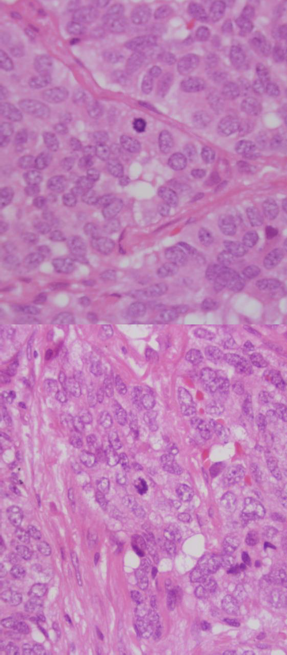
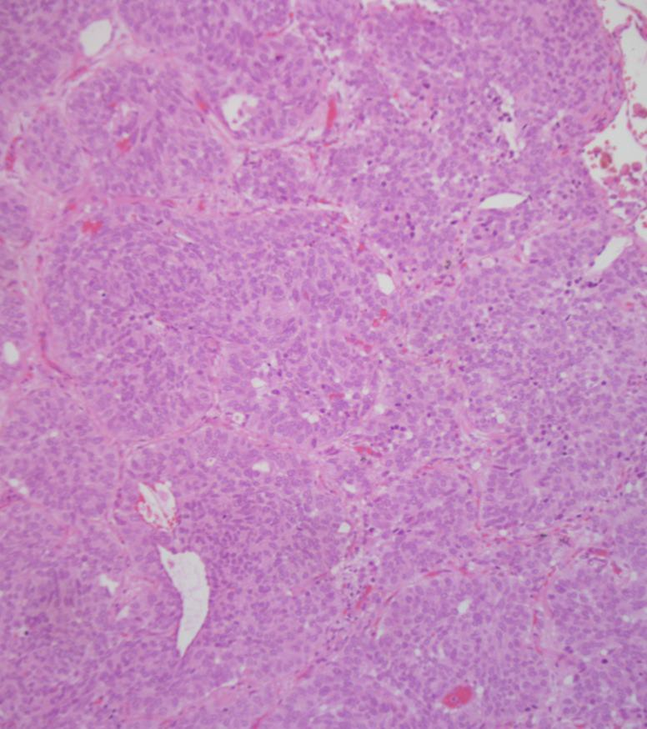

Slide 32
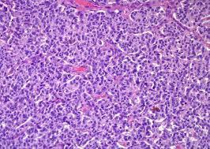
Atypical carcinoid
10% carcinoid tumours
Up to 70% eventually metastasise – 5 year survival 60%
Increased mitotic activity and presence of necrosis.
Pleomorphism, hypercellularity, necrosis, mitoses – 3-10/2mm²

Slide 33
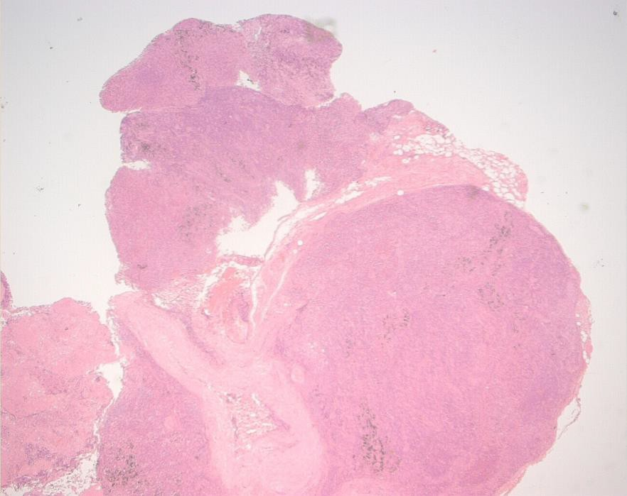
Case 4
F56
Mediastinal mass
Previous excision of thymic cyst

Slide 34
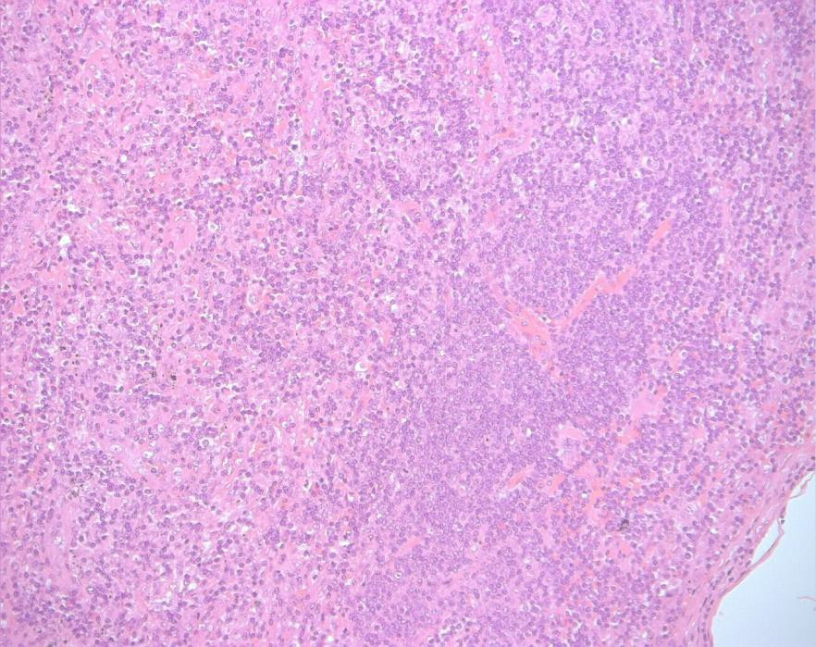
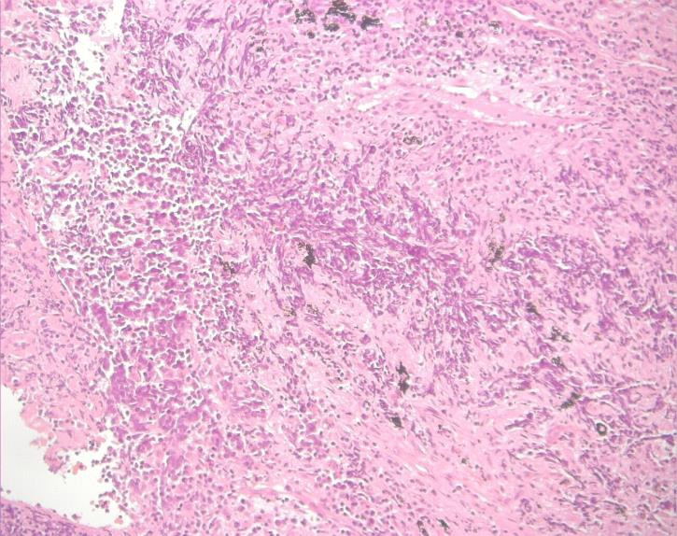
Small or medium round or elongated cells Necrosis
4
Mitoses
Fine granular chromatin indistinct nucleoli Small amount of cytoplasm
Crush artefact, Azzopardi effect

Slide 35
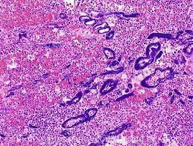
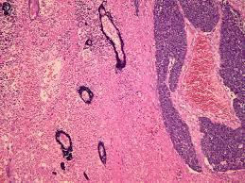
Small cell carcinoma
 | Small cell | Large cell
Cell shape | Round, fusiform | Polygonal
N?C ratio | High | Low
Chromatin | Fine | Coarse
Nuceoli | Indistinct | Prominent
DNA staining of vessels | Frequent | Rare

Slide 36
Small cell immuno
CK7+ve
MNF- paranuclear dot like positivity CD56, synaptophysin

Slide 37
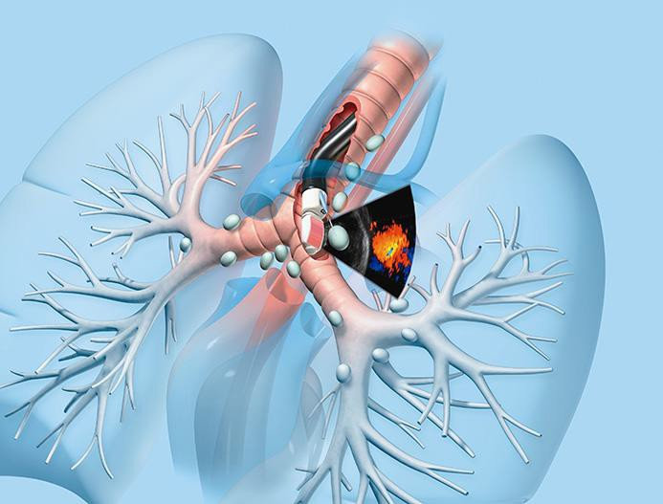
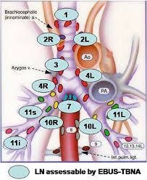
R8
EBUS
Lymph node staging Diagnostic samples

Slide 38
Squamous carcinoma
May show central necrosis and cavitation Nests and strands of cells. Irregular nuclei Keratinisation or intercellular bridges
Variants – papillary, clear cell, small cell and basaloid
Cell type | Usual immunophenotype
Squamous | CK5+, CK7+/-,TTF-1 - , CD56 – p63, p40 +ve
Adeno | CK5-, CK7+, TTF-1 +, CD56 –
Small | CK5-, CK7+, TTF-1+, CD56 +

Slide 39
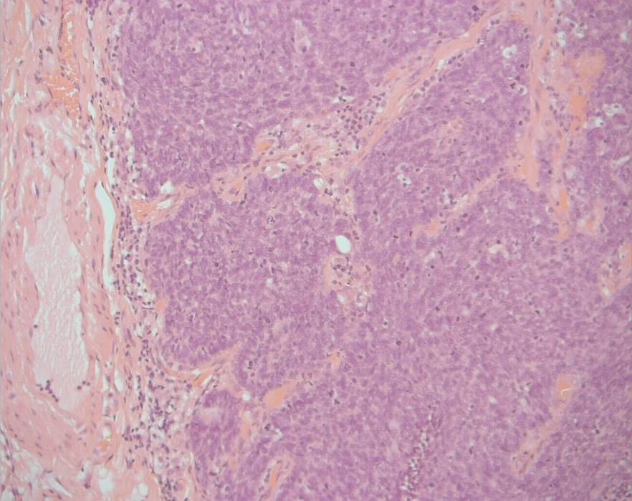
21
M71
T1 tumour RUL
Peripheral palisade
Small hyperchromatic cells
Some studies suggest worse prognosis

Slide 40
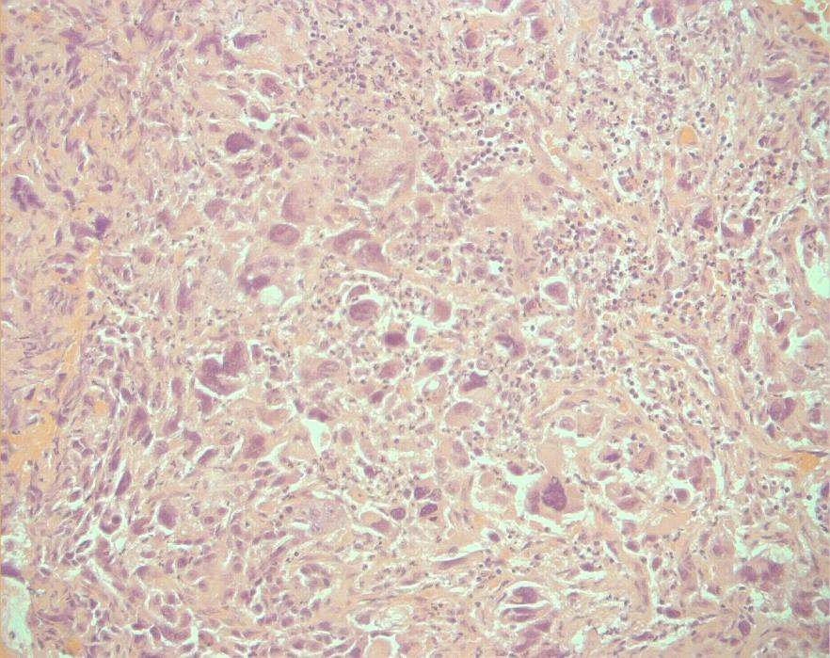
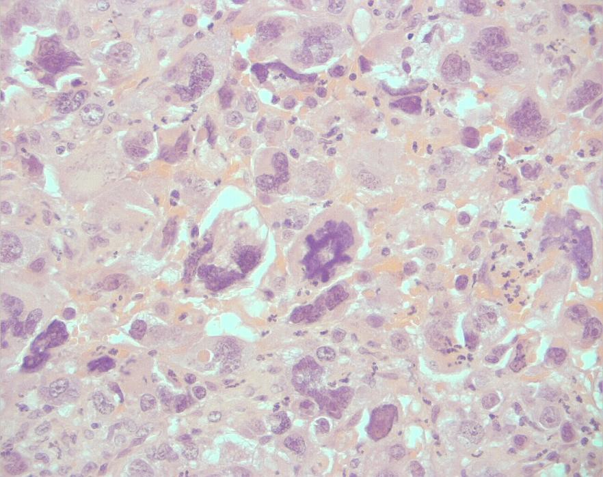
17
F65
Mass in RUL

Slide 41
Pleomorphic/giant cell carcinoma
1% of all malignancies
Cytokeratin, CEA and EMA usually variably expressed.
Sarcomatoid carcinoma
Spindle cell carcinoma Giant cell
Pleomorphic carcinoma

Slide 42
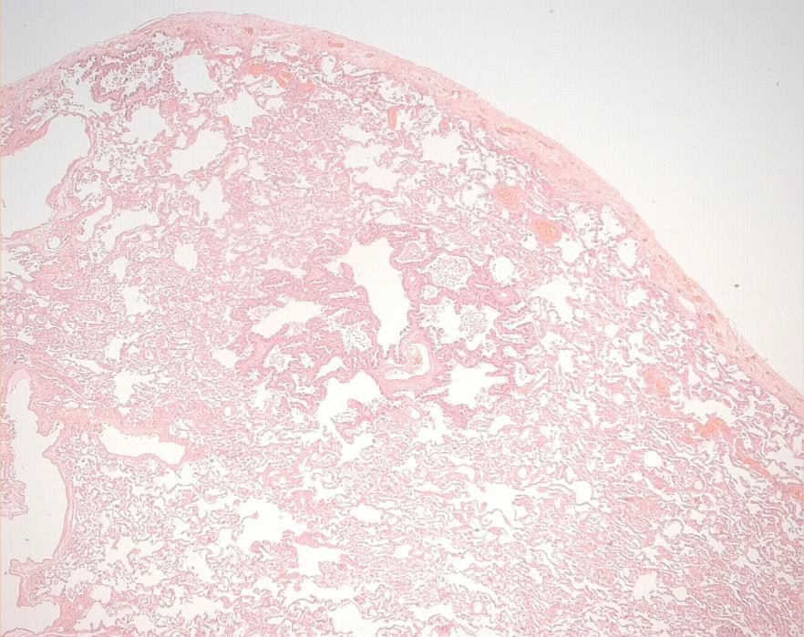
16
M46
Right upper lobe pneumonia Failed to resolve
Hypoxia

Slide 43




Slide 44
Adenocarcinoma
Patterns
Lepidic
Acinar
Papillary
Micropapillary
Solid
Mucinous adenocarcinoma
Foetal
Enteric

Slide 45




Lepidic (BAC)
Monomorphic cells little atypia may be multifocal
Aerogenous dissemination
Immuno
CK7, TTF-1 +ve
CEA, Ber EP4, AUA-1
Mucinous and enteral – CK20,
cdx-2

Slide 46
TNM staging 8th edition
Tx Primary tumour not assessed T2 tumours 30-50mm
Or+ involves main bronchus
Invades visceral pleura
Atelectasis tomhilum
T2a 30-40mm
T2b 40-50mm
T3 tumours 50-70 mm
Or invades parietal pleura, chest wall, phrenic nerve, pericardium, tumour in same lobe
T0
No evidence of primary
Tis
Carcinoma in situ
T1 <30mm
T1mi minimally invasive
T1a
T1b
T1c
<10mm 10-20mm
20-30mm
T4 >70mm
Or in diaphragm,. Heart,vessels, recurrent laryngeal nerve, carina, trachea, oesophagus, vertebra or ipsilateral nerve

Slide 47


22
F68
Recurrent pneumonia RUL collapse

Slide 48

Hamartomas
Disorganised mix of connective and epithelial tissues.
Usually parenchymal, 10% endobronchial Sharply circumscribed
May calcify, ossify

Slide 49


23/30
M56
RUL mass at mitral valve surgery
F53
RML nodules

Slide 50



Chondroid hamartoma/cho
ndroma

Slide 51



Slide 52


Slide 53



Slide 54

Tracheobronchial gland:Tumours of
salivary gland type
Seromucous galnds of bronchial wall are similar to the minor salivary glands.
Adenoid cystic
Slow growing infiltrative
Well demarcated groups with small cyst like
spaces
Myoepithelial differentiation

Slide 55



Mucoepidermoid 0.1%. Main airways
Acinic cell
Epithelial-myoepithelial carcinoma

Slide 56

Infections
R12
F39
Bronchiectasis Shadowing ? cause

Slide 57



Slide 58


Tuberculosis
Mycobacterial infection
Organisms often scanty
Fibro caseous cavitation often apical
Granulomatous inflammation
ZN stain

Slide 59



Death one month post-lung transplant
20

Slide 60
Opportunist infections
Viral
CMV, HSV
Usually in the setting of immunosuppression
Transplant
Immunological disease
Haematological malignancy
Fungal
Candida Aspergillus Mucor

Slide 61

19
M57
Failing renal transplant
Immunosuppressed
Abscess in RLL post Klebsiella pneumonia

Slide 62



Cavities
Necrotising pneumonia
Infarcts
Vasculitis
Mycobacteria
Tumours
Bronchocoeles

Slide 63



27
F76
Polypoid mass occluding L main bronchus
Cough Fever ANCA +ve

Slide 64

F74
Persistent nodule in right lower lobe

Slide 65




Slide 66



Amyloid
May occur as part of generalised amyloidosis or as isolated disease.
Isolated – tumour like nodules
Amorphous eosinophilic material. Giant cell reaction
Mostly light chain
Some senile type transthyretin

Slide 67
INTERSTITIAL LUNG DISEASE
Many diagnosed radiologically UIP
Atypical types get biopsied have atypical histology!
NSIP
EAA
Often have to describe the pattern rather than
give a specific diagnostic entity
Others

Slide 68

13
13
M44
SOB. Reticular change on CT

Slide 69


Pleura
Pattern
Heterogeneity Distribution

Slide 70

Inflammation
Fibrosis
Epithelial changes

Slide 71


UIP, Idiopathic pulm
onary fibrosis
Subpleural and paraseptal predominance Patchy parenchymal involvement
Fibrosis leading to loss of architecture – honeycombing
Fibroblastic foci
Mild to moderate interstitial inflammation
Absence of any other causal feature

Slide 72


UIP
Secondary changes – non specific
Pneumocyte hyperplasia
Mucin and debris in air spaces
Thickened vessel walls
Smooth muscle cell hyperplasia

Slide 73



Slide 74


Fibrosing organising pneumonia

Slide 75

F53
SOBOE
Pernicious anaemia Raynaud’s disease

Slide 76



Changes throughou
Uniform but vary in intensity Architecture preserved.
t

Slide 77

NSIP
Interstitial pneumonia lacking specific features Multifactorial
Common histological pattern in an number of connective tissues disease.
Defines a pattern or category of disease

Slide 78
NSIP – Cellular and Fibrotic
Cellular | Fibrotic
Diffuse involvement of affected parenchyma | Diffuse involvement of affected parenchyma
Moderate chronic interstitial inflammation | Mild to moderate chronic interstitial inflammation
Little or no fibrosis | Variable degree of interstitial fibrosis
Preservation of alveolar architecture | Little loss of alveolar architecture ( no honey combing)

Slide 79
Interstitial Disease Algorithm
Collagen predominant | Patchy, subpleural and subseptal, loss of architecture, honey combing | UIP
 | With chronic peribronchiolar inflammation and possible granulomas | Chronic EAA
 | Stellate peribronchiolar scars | Burnt out LCH
 | No significant architectural distortion | Fibrotic NSIP
 | None of the above | Unclassified fibrosis
Inflammatory predominant | Peribronchiolar granulomas | EAA
 | Peribronchiolar with eosinophils and LH cell | LCH
 | Peribronchiolar with intraluminal pigmented Macrophages | Respiratory bronchiolitis
 | Mild, no specific distribution | Cellular NSIP
 | Dense, no specific distribution | Lymphoid interstitial pneumonia
 | Non-necrotising granulomas along lymphatics | Sarcoidosis
 | Hyaline membranes and fibroblast proliferation | DAD

Slide 80

ILD & CTD
Pleural involvement
Mixed patterns
B cells – germinal centres, plasma cells

Slide 81
F45
RUL wedge biopsy
?Fibrosis

Slide 82




Slide 83


Pleuro-parenchymal fibroelastosis
PPFE

Slide 84


R20
F76
Previous breast Carcinoma Interstitial shadowing

Slide 85


Langerhans cell Histiocytosis
Early lesions of Langerhans cells mingled with eosinophils
Peribronchiolar distribution
May develop small cavities or cysts – pneumothorax
Progress to stellate fibrous scars
LC and eosinophils less apparent with pigmented macrophages present
CD1a S100 positive

Slide 86

Respiratory failure
Double lung transplant

Slide 87



Slide 88


Lymphangioleiomyomatosis(LA
M)
Proliferation of unusual smooth muscle cells Largely confined to women
Plump spindle shaped cells
Nodular thickening of alveolar walls May lead to honeycombing
SMA +ve.
2/3 HMB-45 +ve

Slide 89


Pulmonary vascular disease
25
F53 bilateral lung transplant
M44 Respiratory failure. Bilateral lung transplant

Slide 90

Plexiform lesions
PPH
Liver disease
Congenital heart disease

Slide 91
Pulmonary hypertension
Precapiilary constrictive
PPH, CHD, Portosytemic shunt – liver, Drugs, HHTelangiectasia, CTD | Plexogenic
Precapillary hypoxic
High altitude, COPD, OSA | Smooth muscle extension and longitudinal
Precapillary thromboembolic
CTEPH, Parasites, Tumour | Recanalisation
Capillary
Pulmonary fibrosis, Capillary haemangiomatosis
Post capillary
PVOD, Left sided heart disease | Venous hypertrophy

Slide 92


M31
Bilateral lung transplant for pulmonary hypertension

Slide 93



Slide 94
Very rare
Microvasculopathy
PCH
Centrilobular pattern
Duplication of capillaries
Proliferation of small thin walled capillary vessels
CD34 immunostaining helpful to demonstrate a double layer of capillaries in alveolar walls
Overlap with PVOD

Slide 95


5
M46
Pulmonary hypertension
Lung transplant

Slide 96


Veno occlusive disease and microvascu
lopathy
nary
Cellular intimal thickening in the pulmo veins
Not age related sclerosis
Haemosiderin deposition

Slide 97


9
F38
Bilateral lung transplant Productive cough

Slide 98


Cystic Fibrosis
Amyloid

Slide 99

Bronchiectasis
Infection – measles, pertussis, adenovirus Chemical – gases, gastric acid
Obstruction – tumour, foreign body extrinsic nodes
Cystic fibrosis, ciliary dyskinesia Hypogammaglobulinaemia
Autoimmune
ABPA

Slide 100


Bronchiectaisis
Third or fourth order bronchi Filled with purulent exudate Destruction of bronchial wall Dense inflammatory infiltrate Distal organising pneumonia
Abscess
Empyema

Slide 101



10 and 24
10
F63
Bilateral lung transplant Emphysema
24
F53
Bilateral lung transplant Emphysema

Slide 102



Slide 103
THE END

